Slide 1

Safety Audits
How to prepare and what to expect
Presented by Scott Cole, CSP, SMS, CHST

Slide 2

Thank you, Sponsor

Slide 3

Thank you, Sponsor

Slide 4

Why and When
Required for certifications, registrations, licenses and insurance
Develop and improve education and programs
Preparation
Conclusions
Duty of care
Typically, annually

Slide 5
Audit or Inspection
Audit
Focus on why
Focus on processes
Qualitative
Complex
Create recommendations
Inspection
  Focus on what
  Focus on actions
  Quantitative
  Simple
  Create actions

Slide 6
Benefits
Provides an unbiased, external and independent perspective
Reduces risk
Facilitates excellent educational advancement across the business
Aligns management practices
Provides a consistent interpretation of policy
Demonstrates leadership commitment
Establishes a corrective action plan
Sets the foundation for meaningful leadership objectives

Slide 7

Selecting an Auditor
Certifications / Qualifications
Client List
References
Understand the Objective
Understand the Output

Slide 8

Assembling Your Team
Establish the following:
Facilitator
Scribe
Photographer
Prep Team
Audit Team
Safety Committee
Sponsor

Slide 9

Preparing
Workspace for auditor(s)
Quiet space – Post signs
Receptacle
Internet access
Printer access
Disinfecting wipes
Accessibility
Bathrooms
Food and drink
Liaison

Slide 10
Preparing
Communications
Leadership
Workers
Contractors
Physical Considerations
Housekeeping
Paths of travel
Interviews
Employees
Employee Representatives
Supervisor
Vendors

Slide 11

Preparing
Paperwork
Filing system
Organization
Retention rights
Access offsite?

Slide 12
Key Documentation
Inspections
Maintenance
Disciplinary records
Health records
Exposure assessments
Orientation records
Previous audit records
Policies
OSHA Logs
Investigations
First aid logs
Training
Manufacturer’s documentation
SOPs
Committee meeting minutes

Slide 13

Debrief and Report
Clear and concise
Gives you the knowledge to learn more
Prioritized
Under cover
Executive summary

Slide 14

Prioritizing

Slide 15
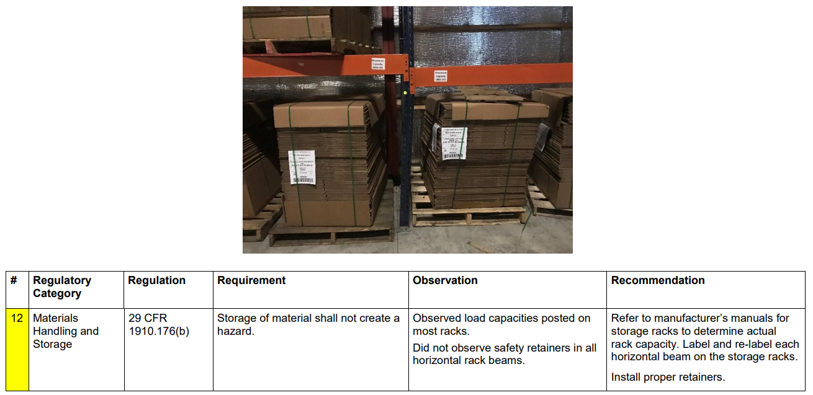

Slide 16

Thank you!
Scott Cole
216-318-3878
colesafetyservices@yahoo.com

